Slide 1
FRUIT

Slide 2
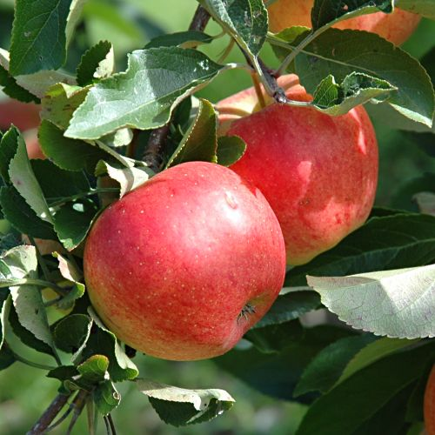
1. Malus domestica, appel

Slide 3
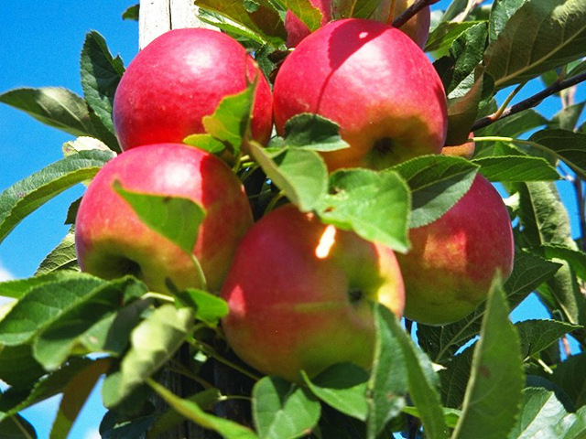
2. Malus ‘Elstar’, appel

Slide 4
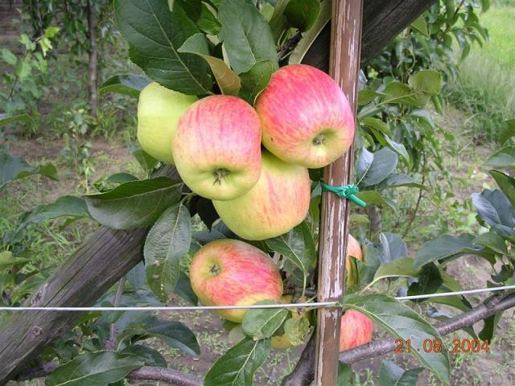
3. Malus 'James Grieve‘, appel

Slide 5
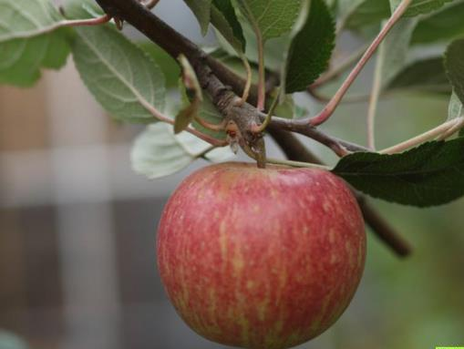
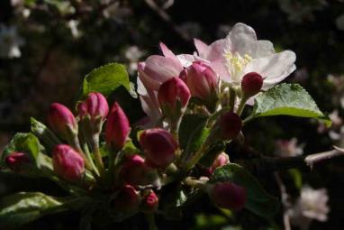
4. Malus 'Schone van Boskoop‘, appel

Slide 6
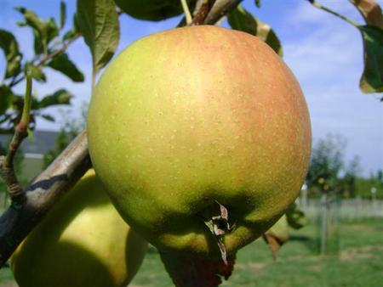
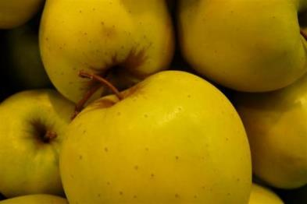
5. Malus 'Golden Delicious'

Slide 7
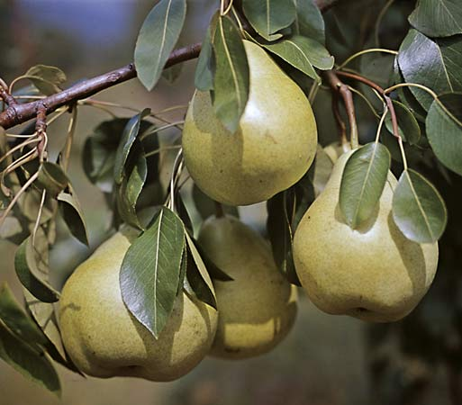
6. Pyrus communis

Slide 8
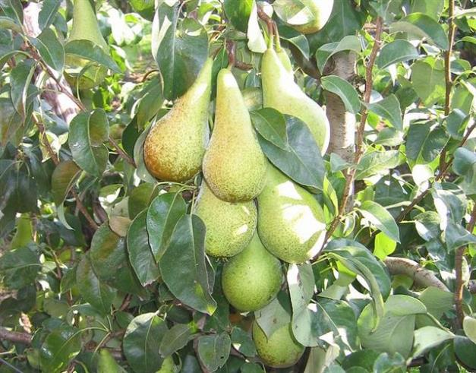
7. Pyrus 'Conference'

Slide 9
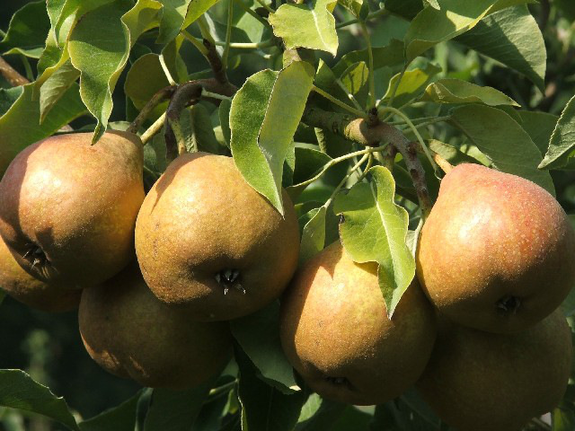
8. Pyrus ''Gieser Wildeman'

Slide 10
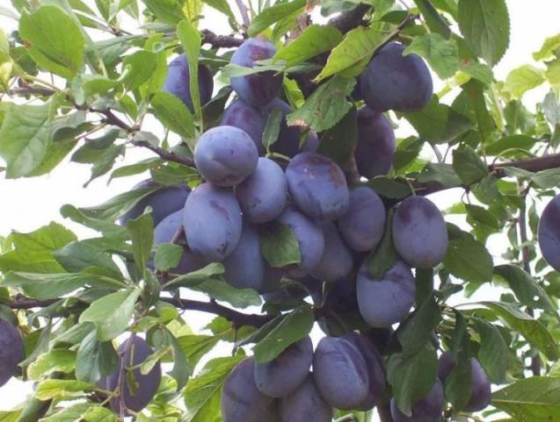
9. Prunus domestica

Slide 11
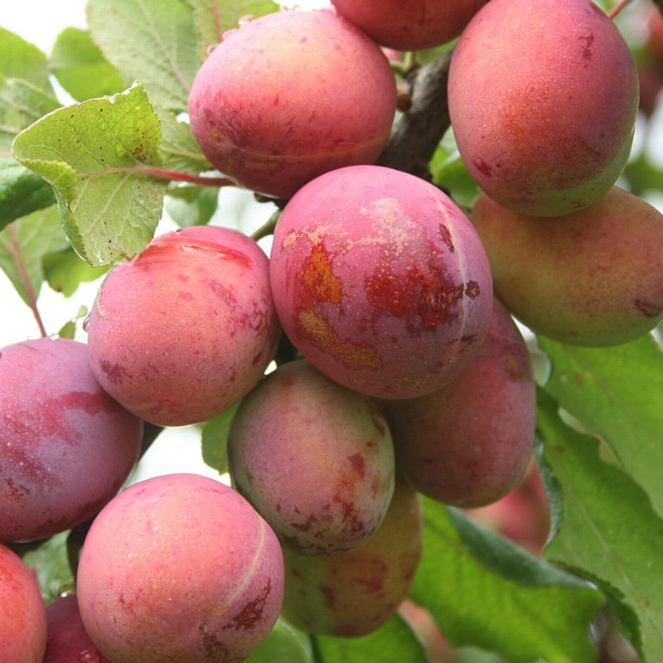
10. Prunus 'Opal'

Slide 12
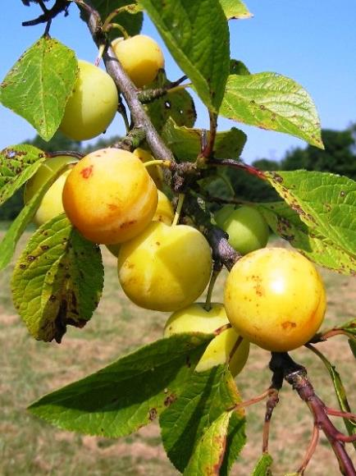
11. Prunus 'Reine Glauda Verte'

Slide 13
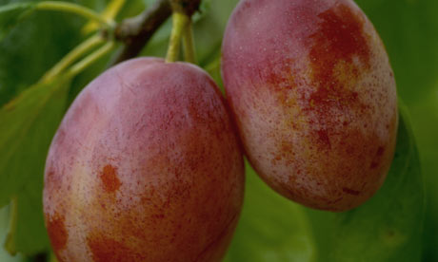
12. Prunus 'Victoria'

Slide 14
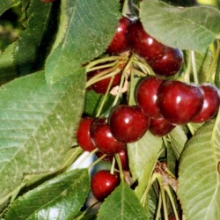
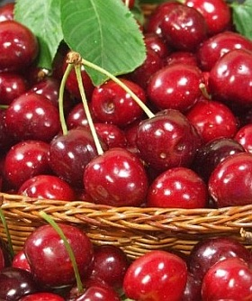
13. Prunus avium en Prunus cerasus, rode kers

Slide 15
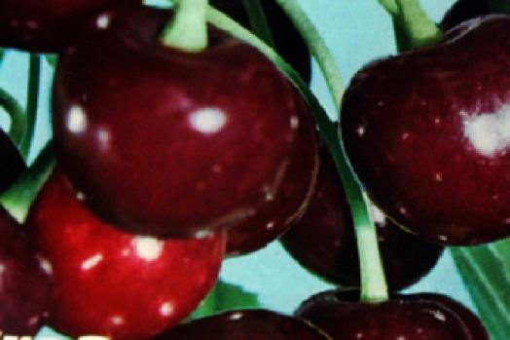
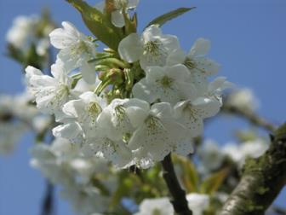
14. Prunus 'Dubbele Meikers'

Slide 16
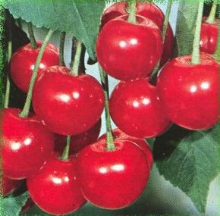
15. Prunus 'Early Rivers'

Slide 17
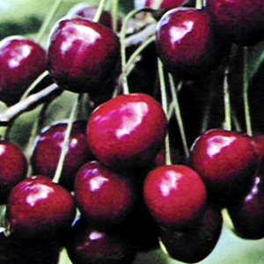
16. Prunus 'Rheinische Schattenmorelle'

Slide 18
KLEINFRUIT

Slide 19
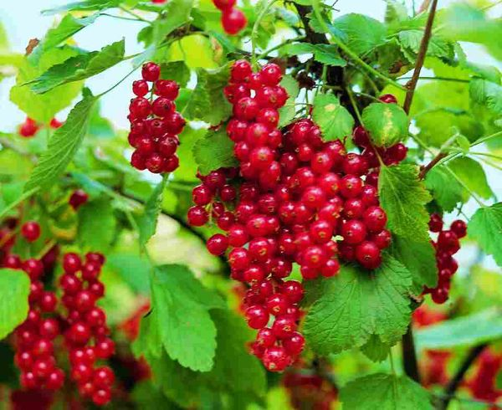
1. Ribes rubrum 'Jonkheer van Tets‘, aalbes

Slide 20
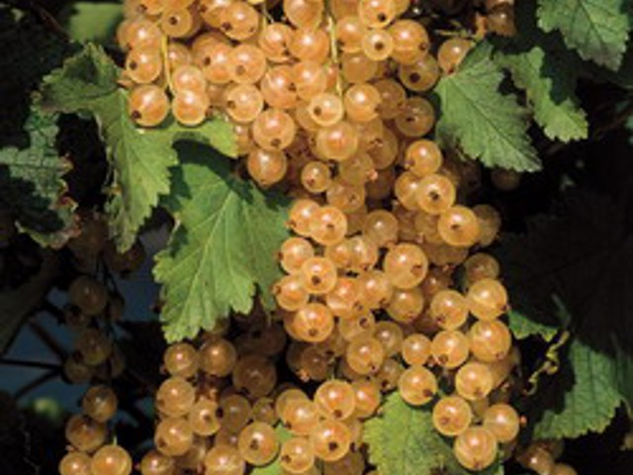
2. Ribes rubrum “Witte Parel”, aalbes

Slide 21
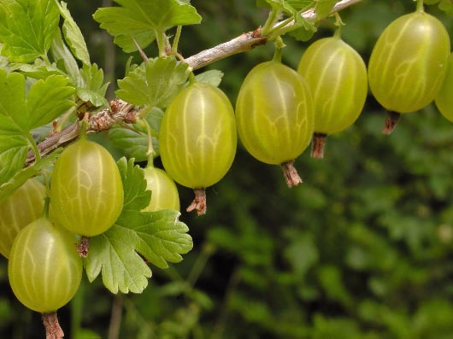
3. Ribes uva-crispa 'Invicta‘, kruisbes

Slide 22
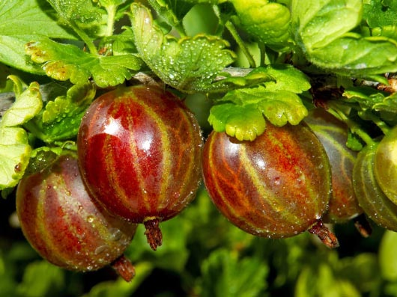
4. Ribes uva-crispa 'Hinnonäki Röd‘, kruisbes

Slide 23
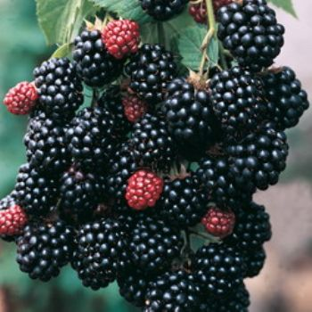
5. Rubus 'Black Satin‘, (doornloze) braam

Slide 24
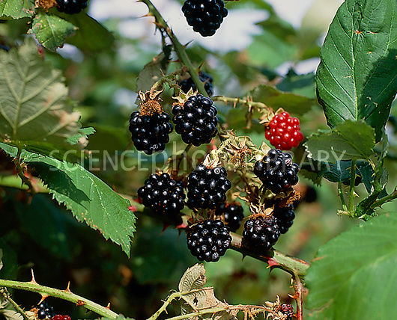
6. Rubus 'Himalaya‘, braam

Slide 25
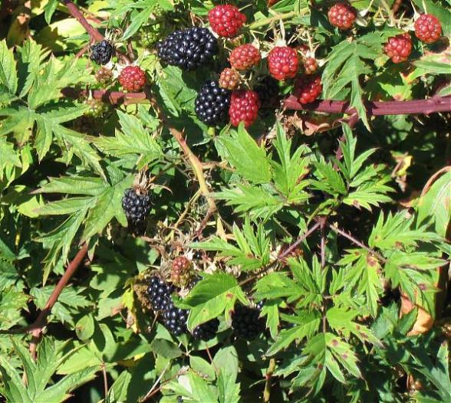
7. Rubus 'Thornless Evergreen‘ (doornloze) braam.

Slide 26
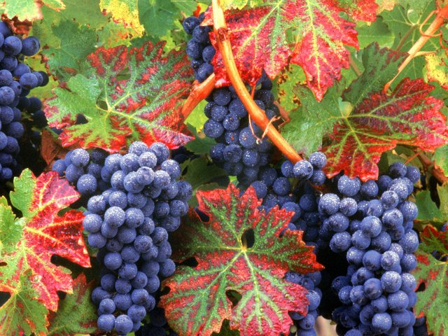
8. Vitis 'Boskoop Glory‘, druif

Slide 27
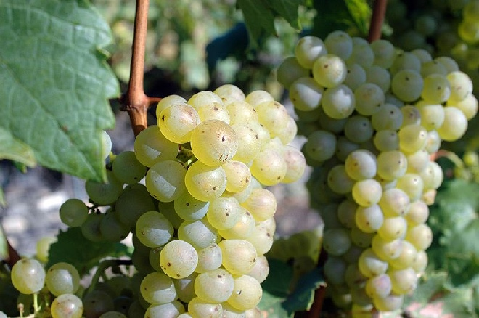
9. Vitis 'Bianca‘, witte druif

Slide 28
GROENTE

Slide 29
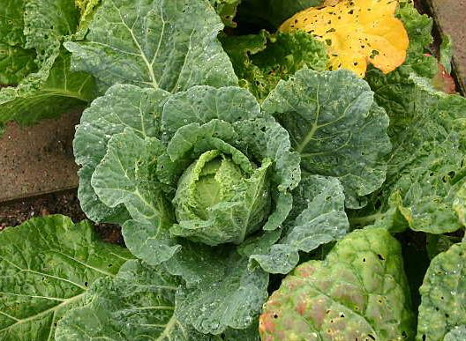
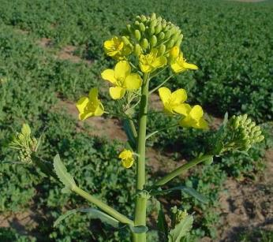
1. Brassica, kool

Slide 30
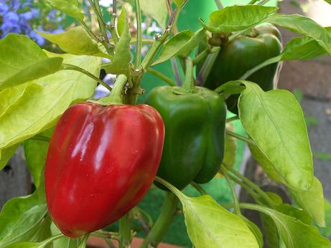
2. Capsicum annuum, paprika

Slide 31
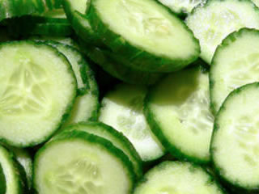
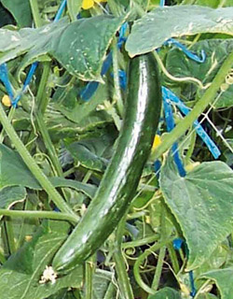
3. Cucumis sativus, komkommer

Slide 32
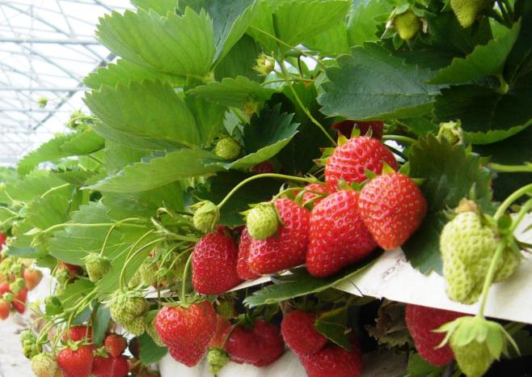
4. Fragaria cultivars, aardbei

Slide 33
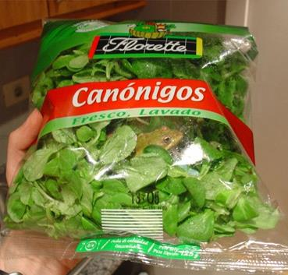
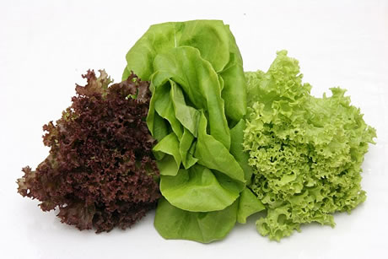
5. Lactuca sativa, sla

Slide 34
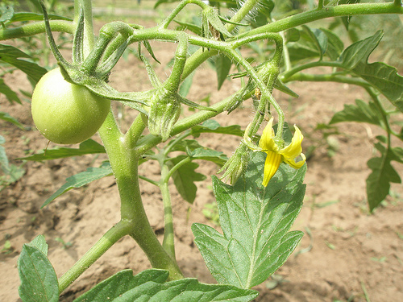
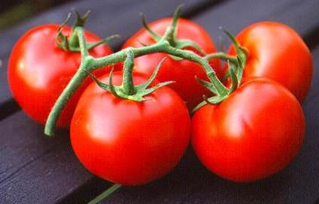
6. Solanum lycopersicum. Tomaten

Slide 35
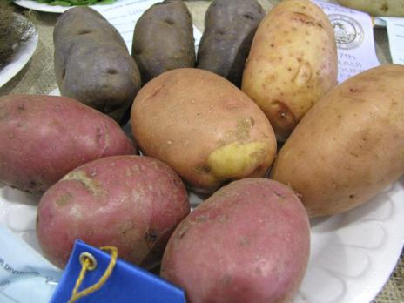
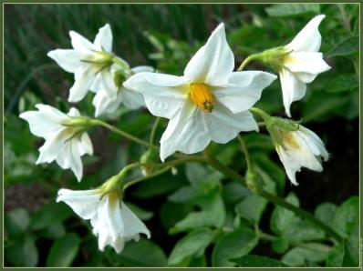
7. Solanum tuberosum. Aardappelen

